Slide 1

NSG Pilkington – University of Liverpool Machine Learning Project: 17/02/2021
Dr. Peter Green
Diego Echeverria
Sarini Jayasinghe
Risk Institute,
School of Engineering

Slide 2
List of activities
Relocate the “Standardise” pre-processing task outside the pipeline.
Include the bias term in the Linear Regression equation.
Exclusion periods in the data from 01/08/19 to 21/03/20 and possible testing data.
Use the data from 25/07/20 to 04/01/21 as the training dataset and test the model on the previous data periods.

Slide 3
List of activities
Relocate the “Standardise” pre-processing task outside the pipeline.
Include the bias term in the Linear Regression equation.
Exclusion periods in the data from 01/08/19 to 21/03/20 and possible testing data.
Use the data from 25/07/20 to 04/01/21 as the training dataset and test the model on the previous data periods.
All the following tasks have been obtained using a training dataset without correlated inputs, without “9395 Main Gas Pressure (OP)” and ignoring inputs whose time lags are < 1 hour

Slide 4
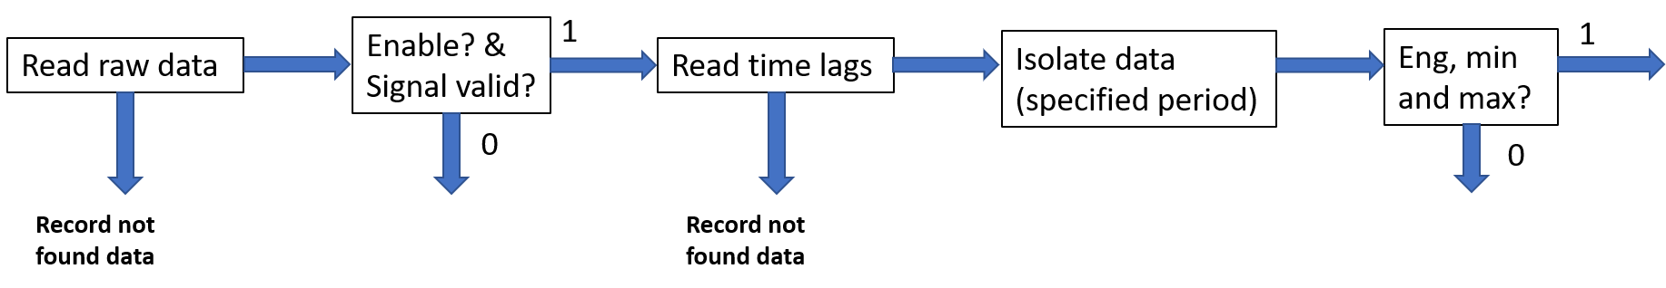
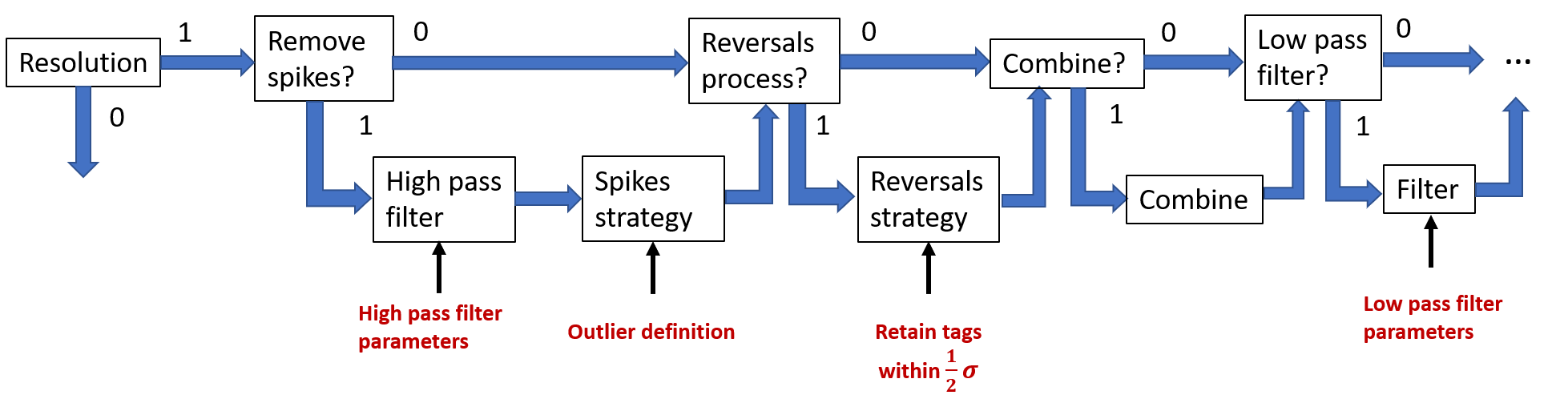
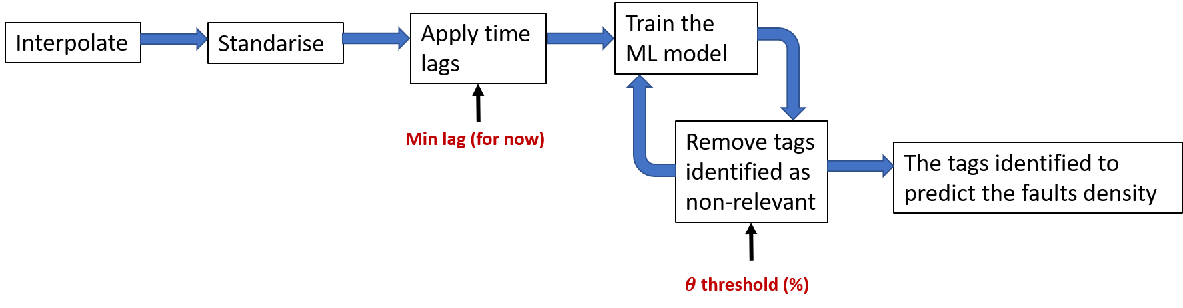

Slide 5
Application pipeline
Pre-processing pipeline

Slide 6
Application pipeline
Pre-processing pipeline

Slide 7
List of activities
Relocate the “Standardise” pre-processing task outside the pipeline.
Include the bias term in the Linear Regression equation.
Exclusion periods in the data from 01/08/19 to 21/03/20 and possible testing data.
Use the data from 25/07/20 to 04/01/21 as the training dataset and test the model on the previous data periods.

Slide 8
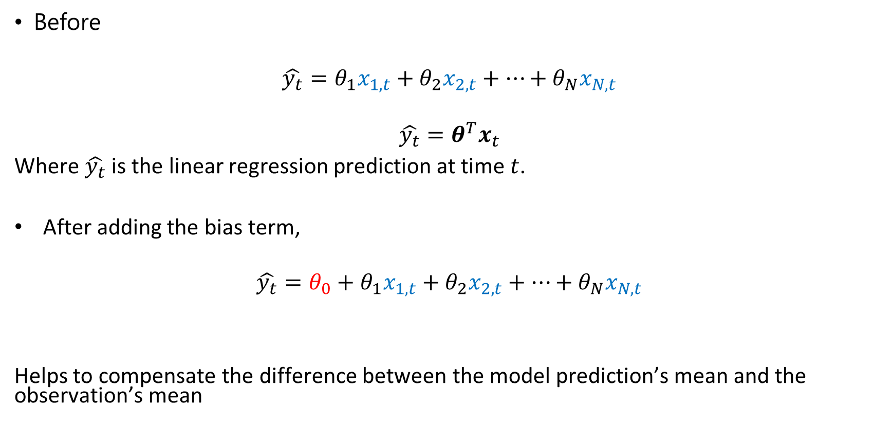
Linear Regression:
Before
$$\hat{y_{t}}=θ_{1}x_{1,t}+θ_{2}x_{2,t}+…+θ_{N}x_{N,t}$$
$$\hat{y_{t}}=θ^{T}x_{t}$$
Where $\hat{y_{t}}$ is the linear regression prediction at time $t$.
After adding the bias term,
$$\hat{y_{t}}=θ_{0}+θ_{1}x_{1,t}+θ_{2}x_{2,t}+…+θ_{N}x_{N,t}$$
Helps to compensate the difference between the model prediction’s mean and the observation’s mean
Bias term

Slide 9
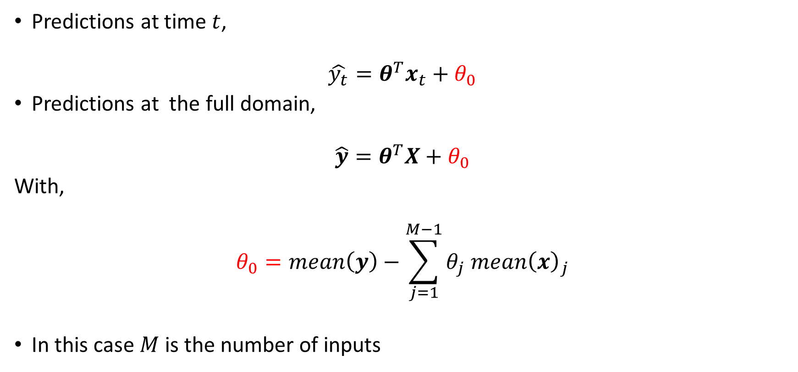
Linear Regression:
Predictions at time $t$,
$$\hat{y_{t}}=θ^{T}x_{t}+θ_{0}$$
Predictions at the full domain,
$$\hat{y}=θ^{T}X+θ_{0}$$
With,
$$θ_{0}=mean\left(y\right)−\sum_{j=1}^{M−1}{θ_{j} mean{\left(x\right)}_{j}}$$
In this case $M$ is the number of inputs

Slide 10
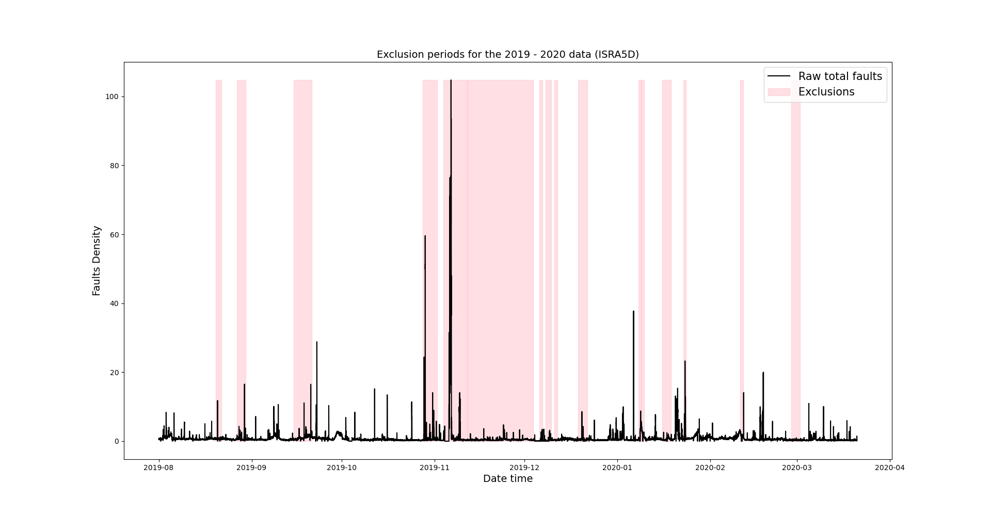
Exclusion periods from 01/08/19 to 21/03/20 (previous data)

Slide 11
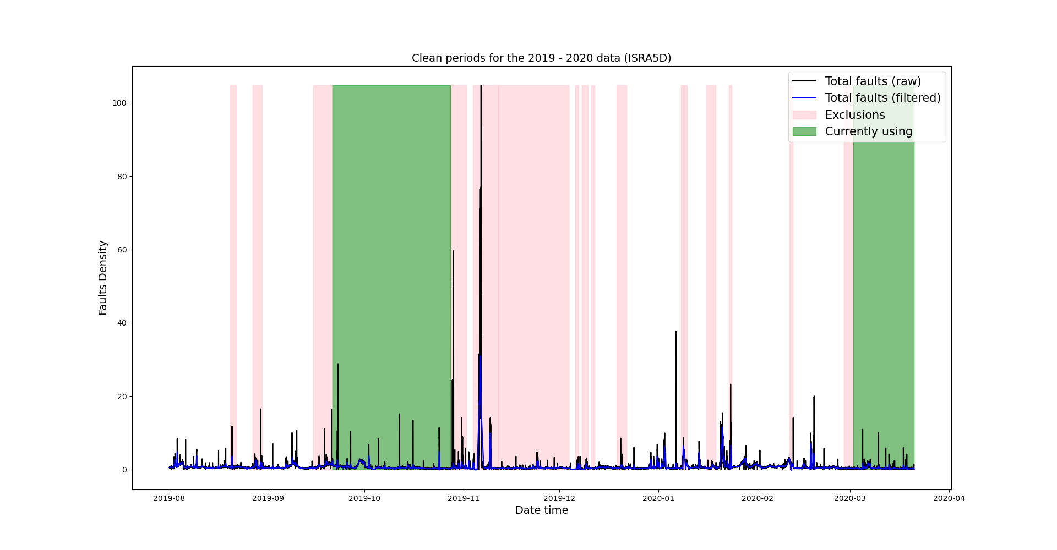
Exclusion periods from 01/08/19 to 21/03/20 (previous data)

Slide 12
Exclusion periods from 01/08/19 to 21/03/20 (previous data)
1 month and 3 days
12 days

Slide 13
Exclusion periods from 01/08/19 to 21/03/20 (previous data)
In the second region we actually have less data than we thought we had
1 month and 3 days
12 days

Slide 14
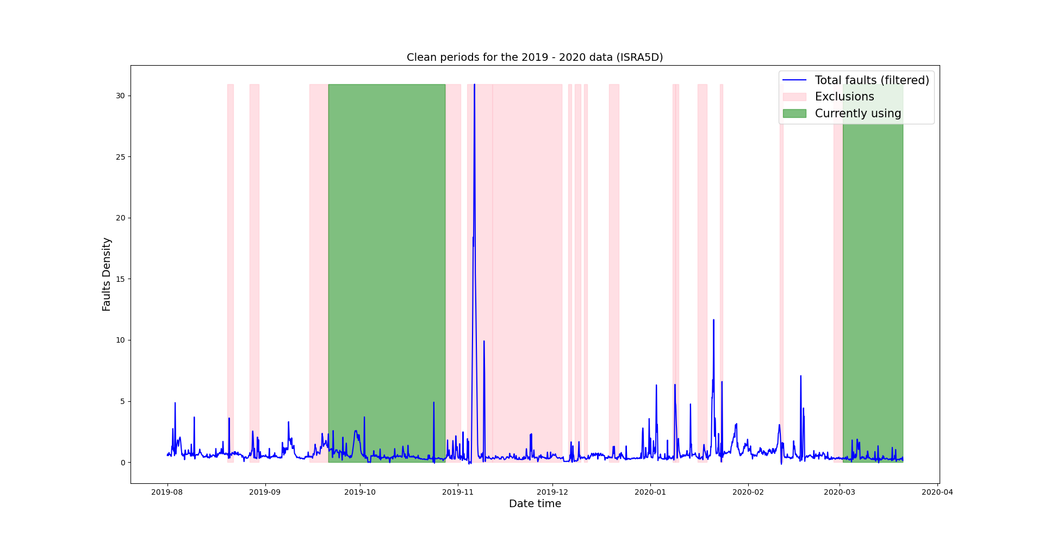
Exclusion periods from 01/08/19 to 21/03/20 (previous data)
Possible data that could be used for testing the model

Slide 15
Test (1): Data from the first region is used for training
Training
Testing

Slide 16
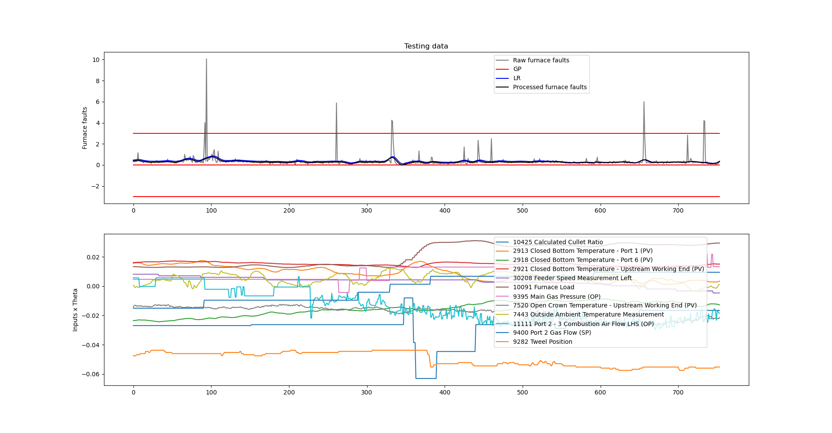
Linear Regression (test 1): autoregressive
Without bias term
With bias term

Slide 17
Linear Regression (test 1): autoregressive
Without bias term
With bias term
Zoom in

Slide 18
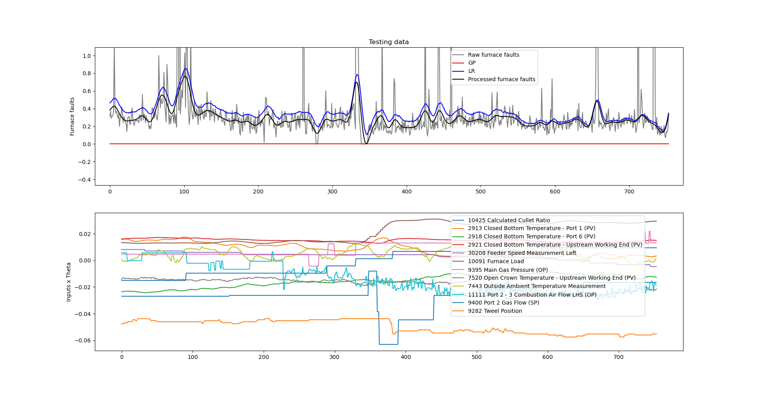
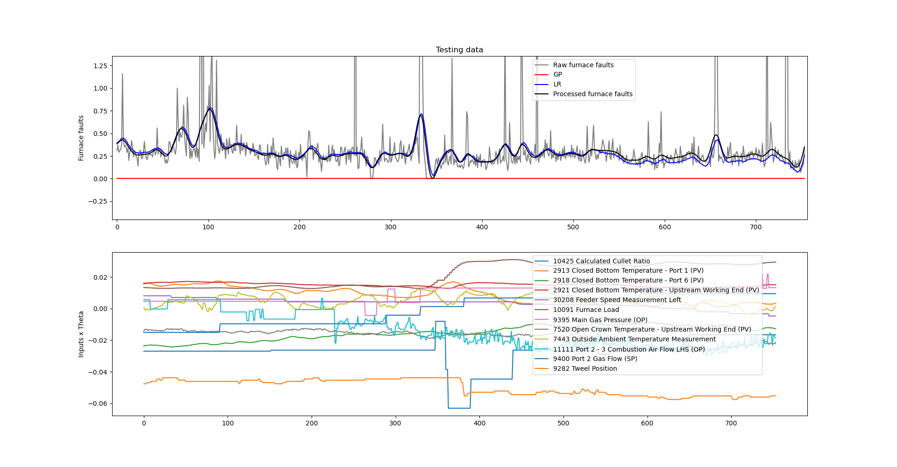
Linear Regression (test 1): autoregressive
Without bias term
With bias term

Slide 19
Test (2): Data from the second region is used for training
Testing
Training

Slide 20
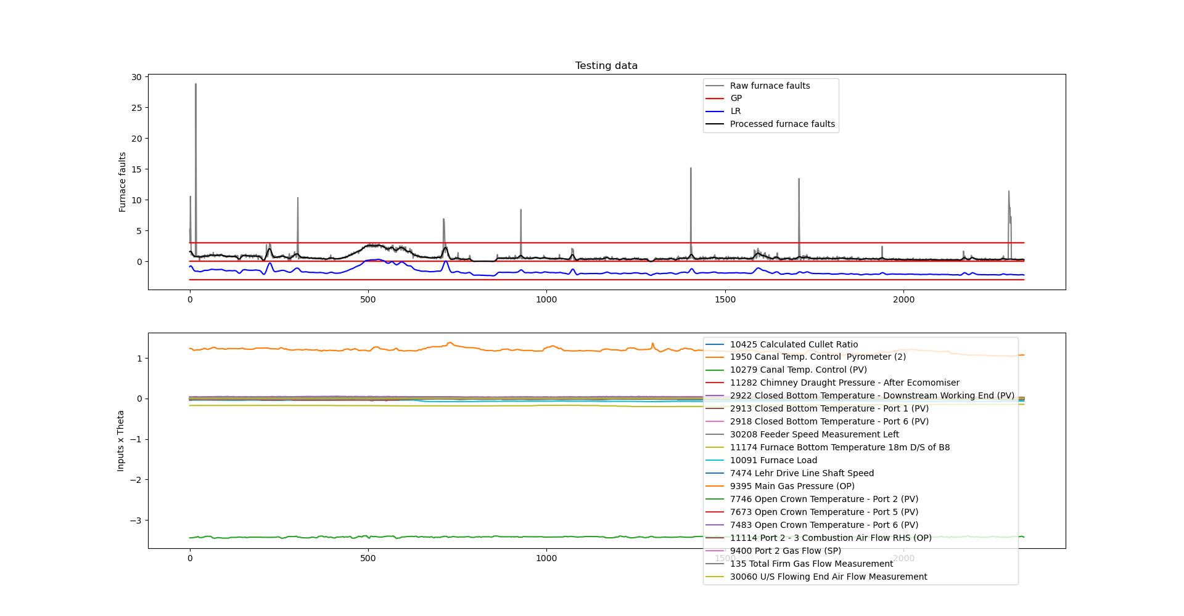

Linear Regression (test 2): autoregressive
Without bias term
With bias term

Slide 21
Linear Regression (test 2): autoregressive
Without bias term
With bias term
Zoom in

Slide 22
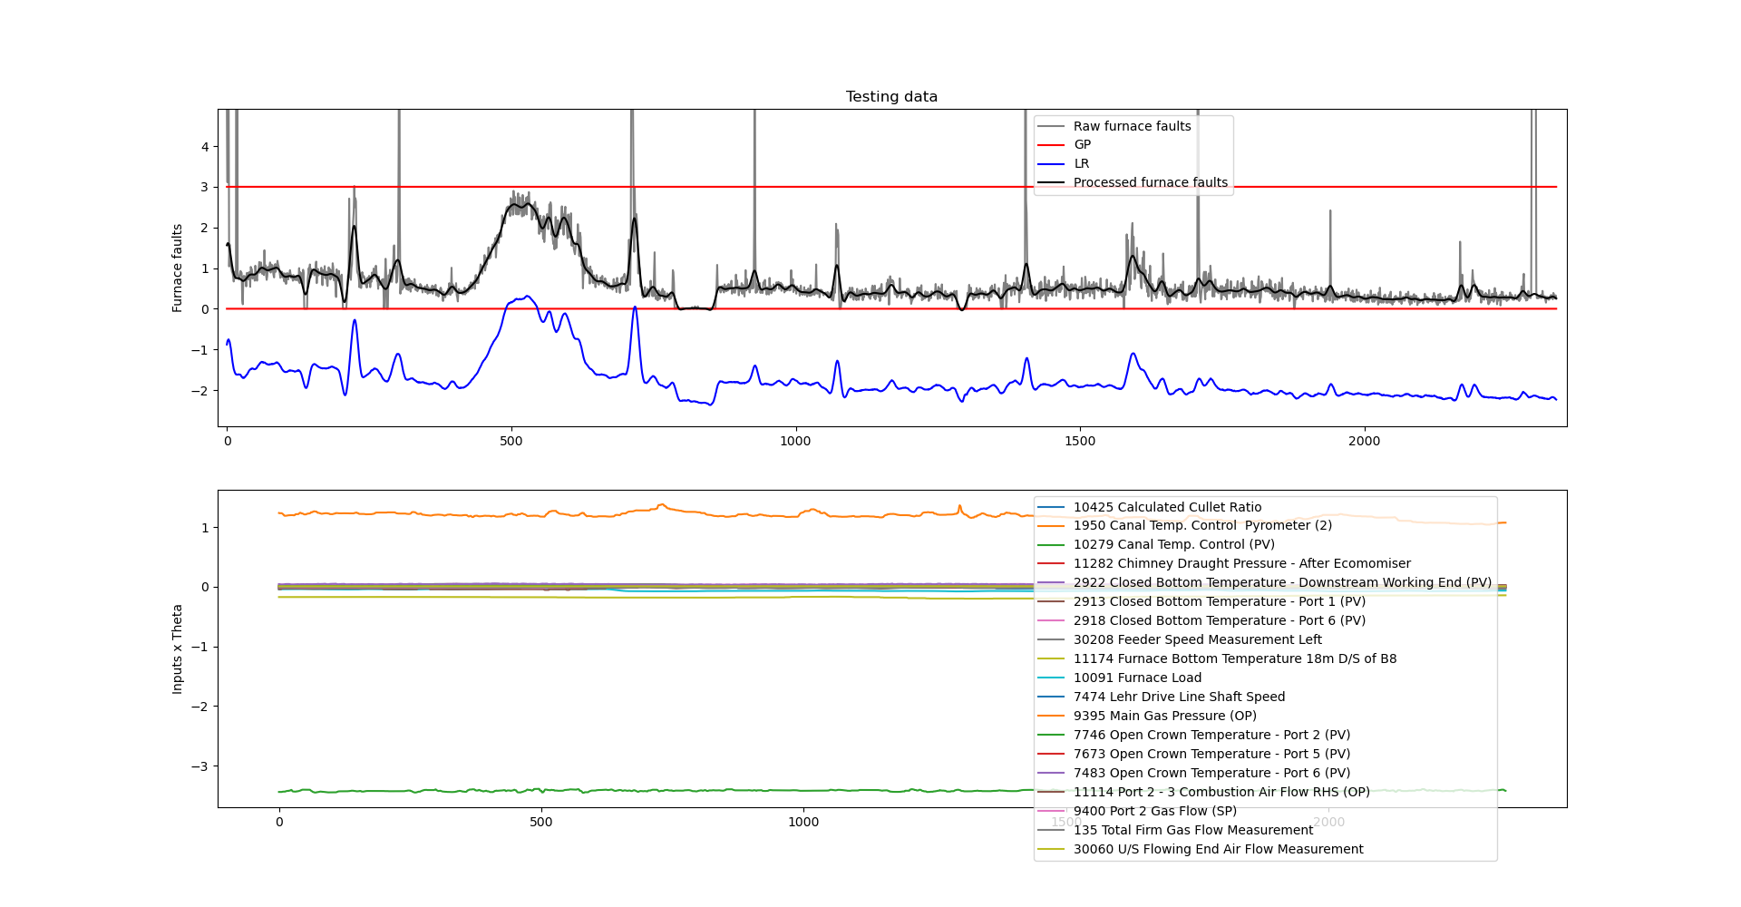
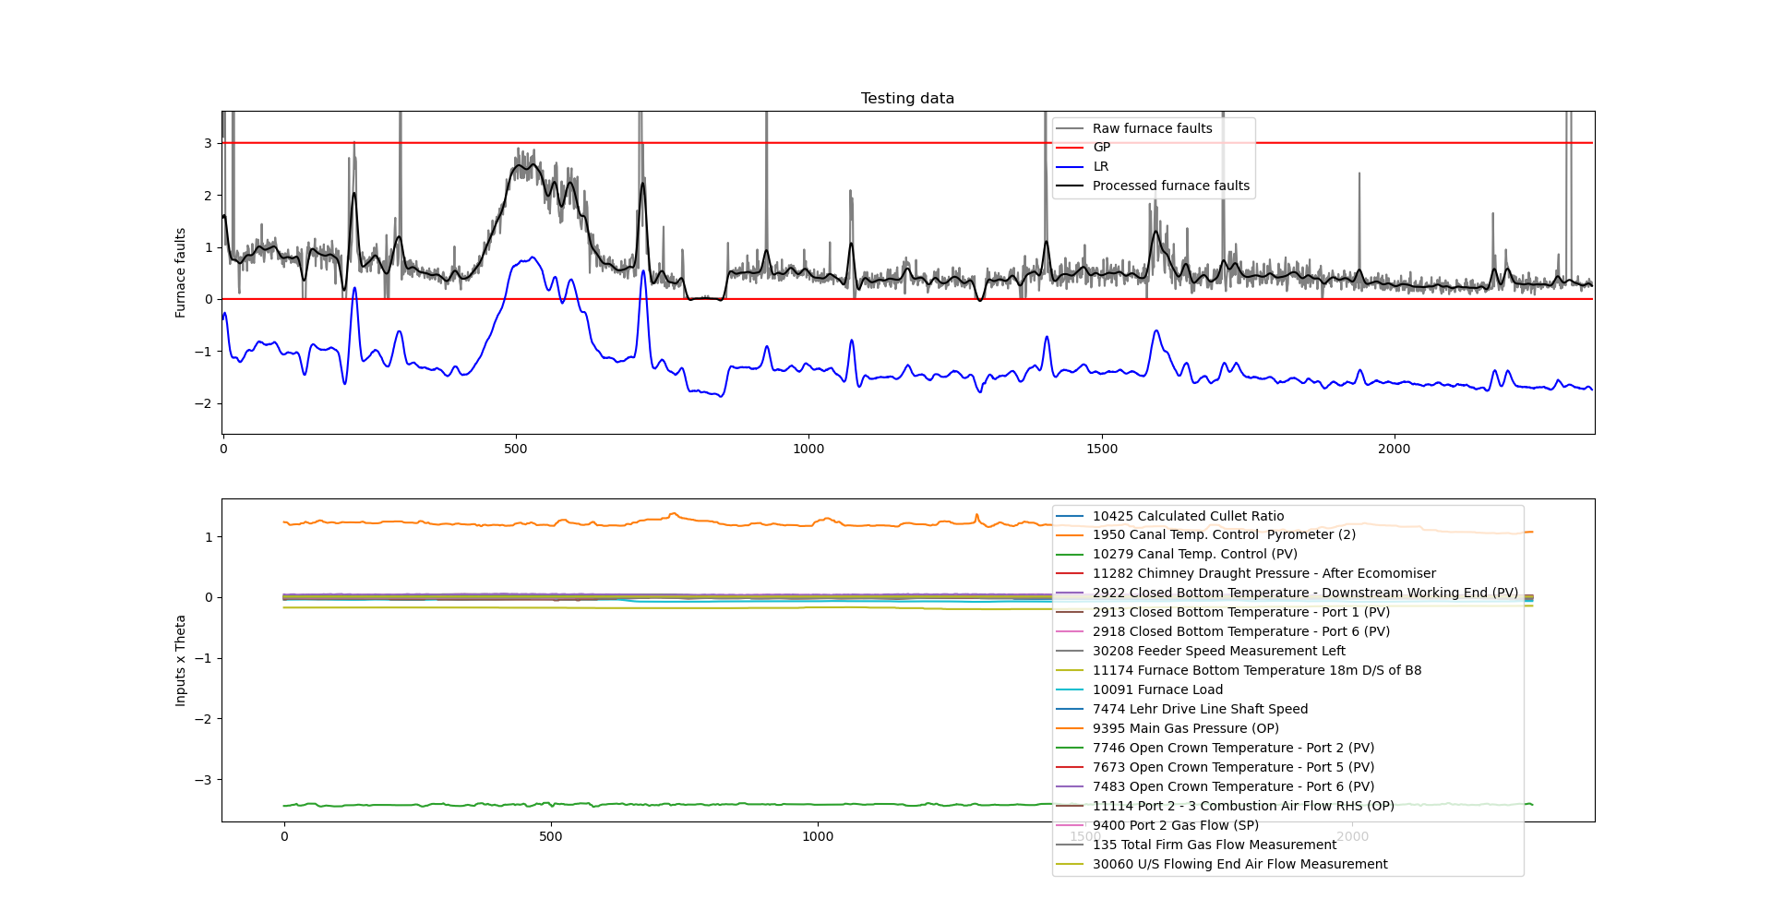
Linear Regression (test 2): autoregressive
Without bias term
With bias term

Slide 23
MSE scores comparison:
The relevant inputs are the same as in the previous presentation.
With bias term Without bias term
 | LR | GP
Test (1) | 0.00109 | -
Test (2) | 3.48479 | -
Score | 1.74294 | -
 | LR | GP
Test (1) | 0.00526 | -
Test (2) | 5.55525 | -
Score | 2.78025 | -

Slide 24
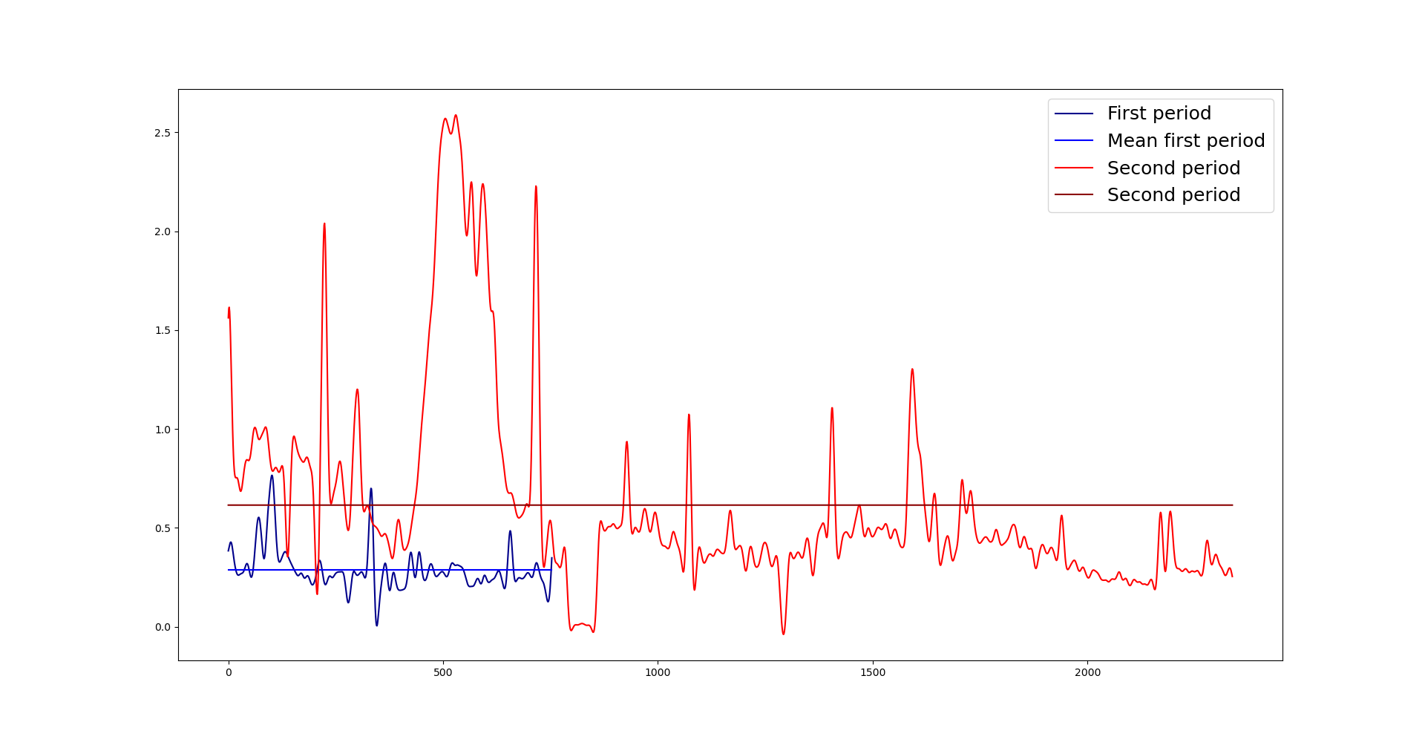
Scales comparison:
The scale of the data from the period from 21/09/19 to 25/10/19 is greater than the scale of the data from the second period from 07/03/20 to 19/03/20.

Slide 25
Possible causes:
The scale of the first data period (from 21/09/19 to 25/10/19) is greater than the second data period (from 07/03/20 to 19/03/20.
Because we are using sets of data that are far apart from each other, we see this difference in the scale of the two datasets.
We are not standardising the lagged output used as an input.

Slide 26
List of activities
Relocate the “Standardise” pre-processing task outside the pipeline.
Include the bias term in the Linear Regression equation.
Exclusion periods in the data from 01/08/19 to 21/03/20 and possible testing data.
Use the data from 25/07/20 to 04/01/21 as the training dataset and test the model on the previous data periods.

Slide 27
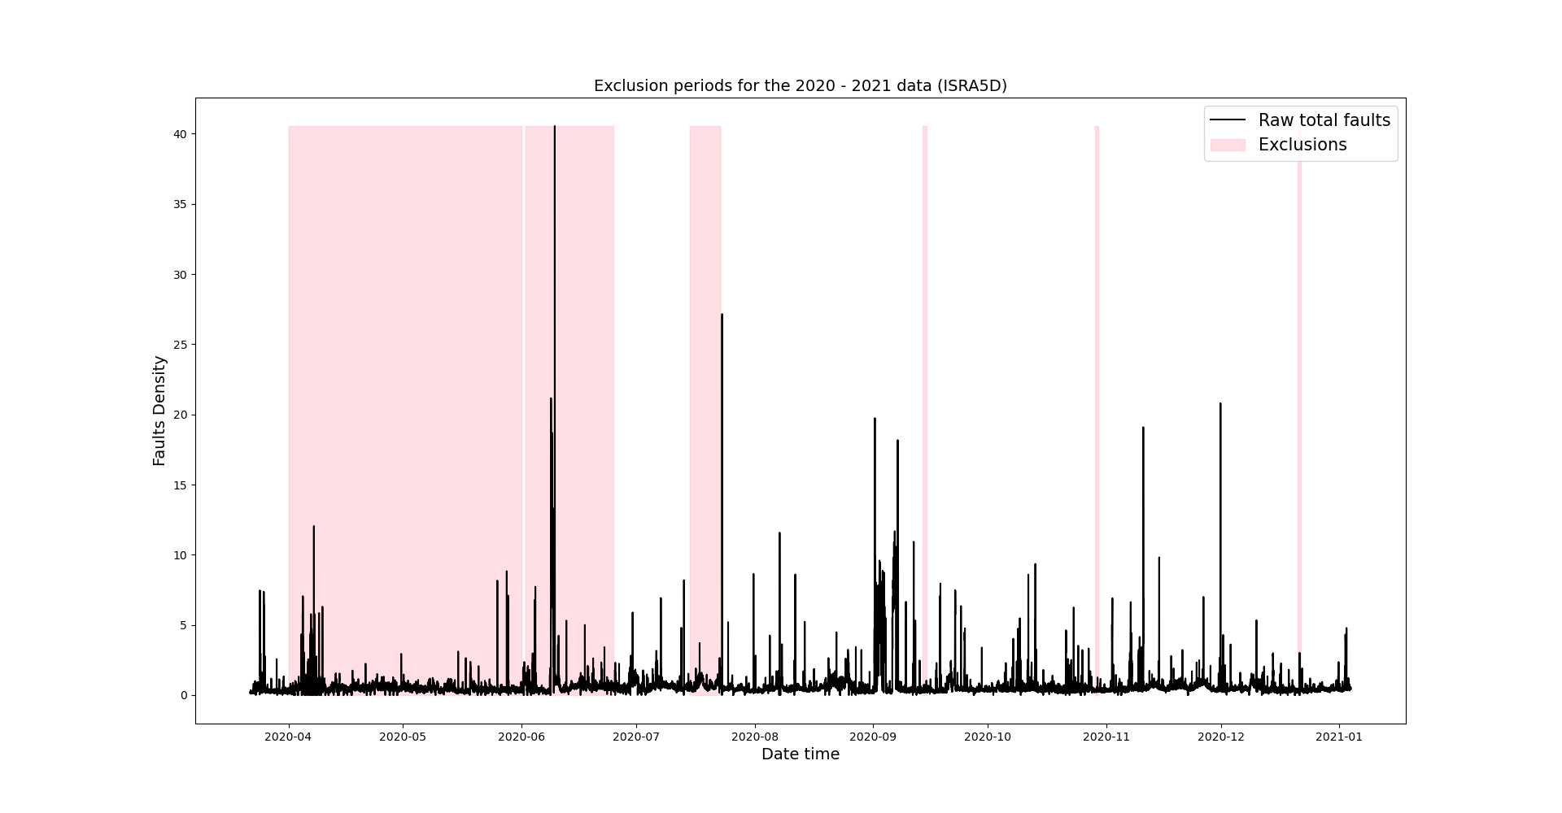
Exclusion periods for the data 2020 - 2021
1 day
1 day
1 day
Training data

Slide 28
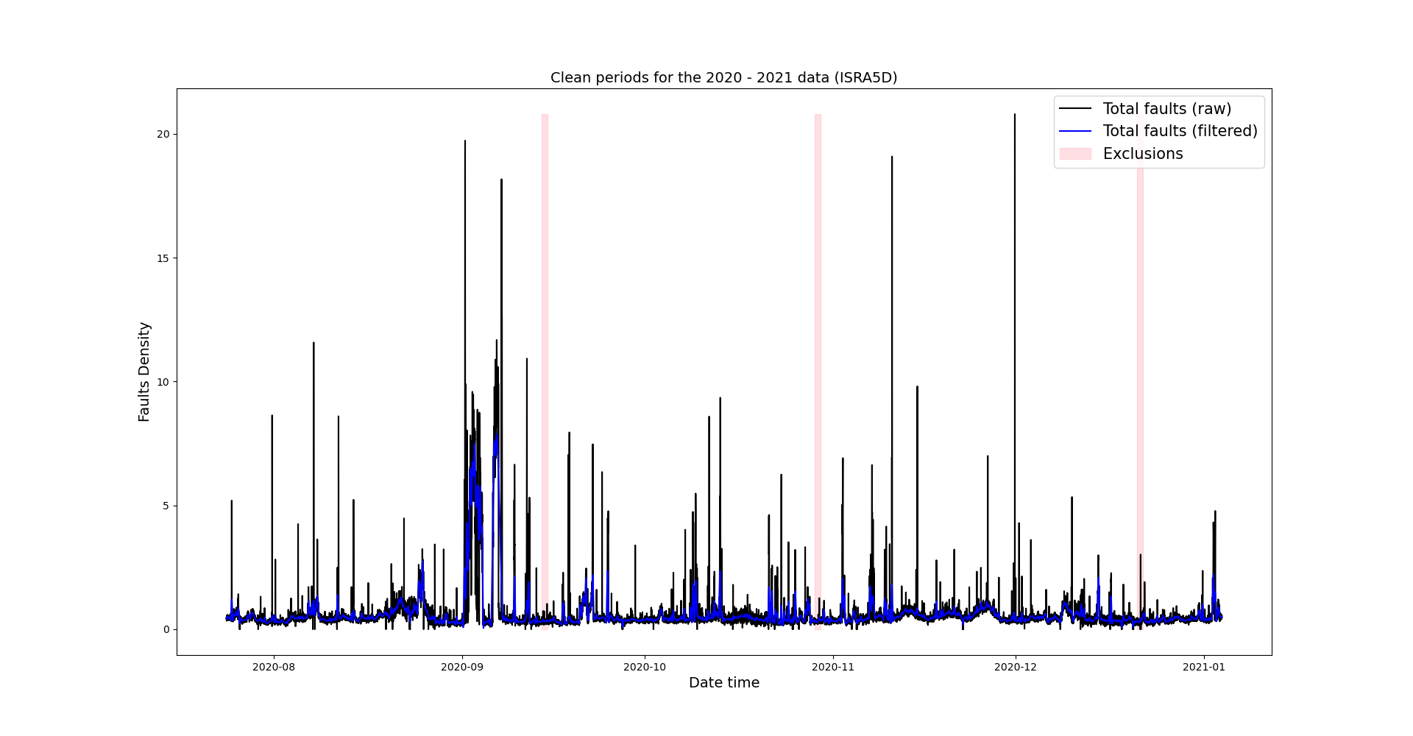
Exclusion periods for the data 2020 - 2021

Slide 29
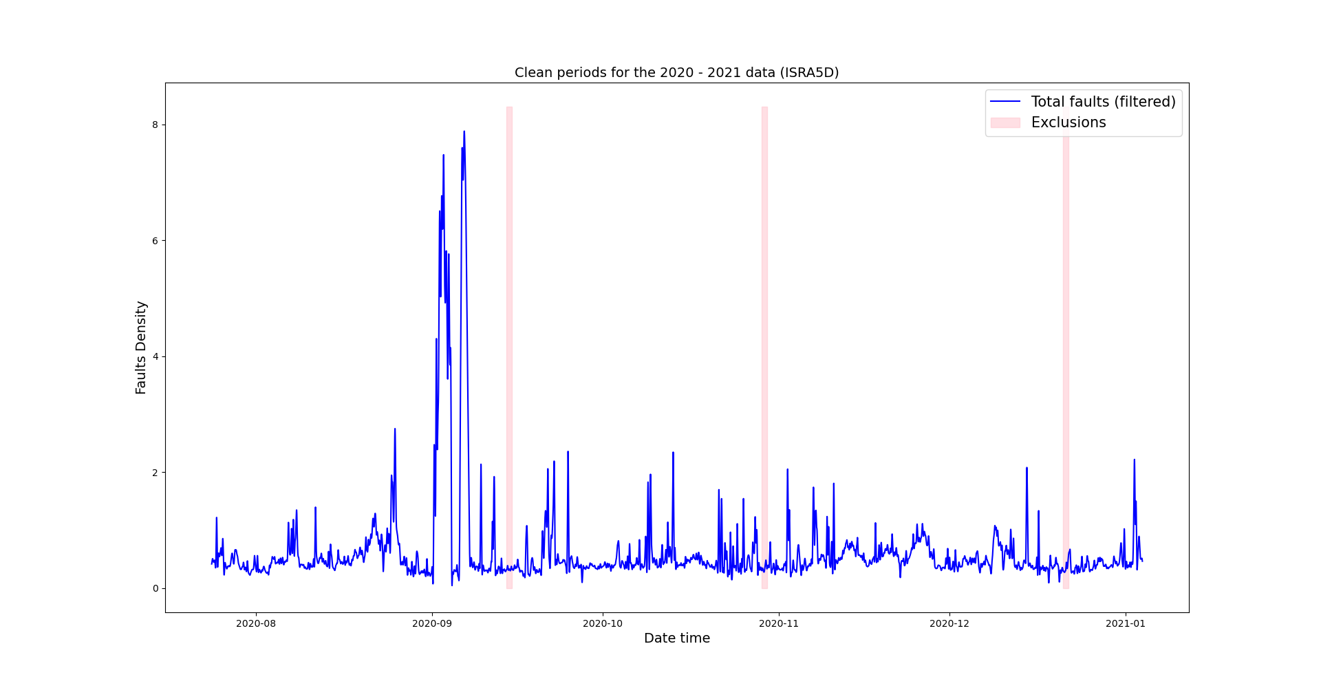
We use this data for training the LR model: Faults density after removing outliers

Slide 30
We use this data for training the LR model: Faults density after removing outliers
N = 11626

Slide 31
We use the clean regions of previous data (from 01/08/19 to 21/03/20) for testing the LR model
Testing
Testing

Slide 32
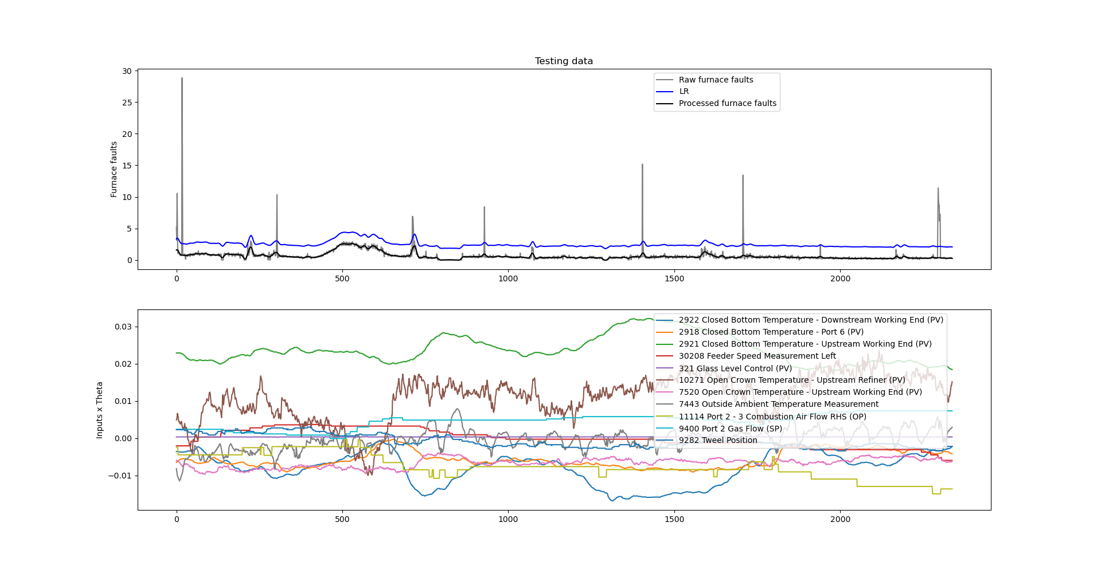
Test (1): Testing the model in the first region of the previous data from 01/08/19 to 21/03/20

Slide 33
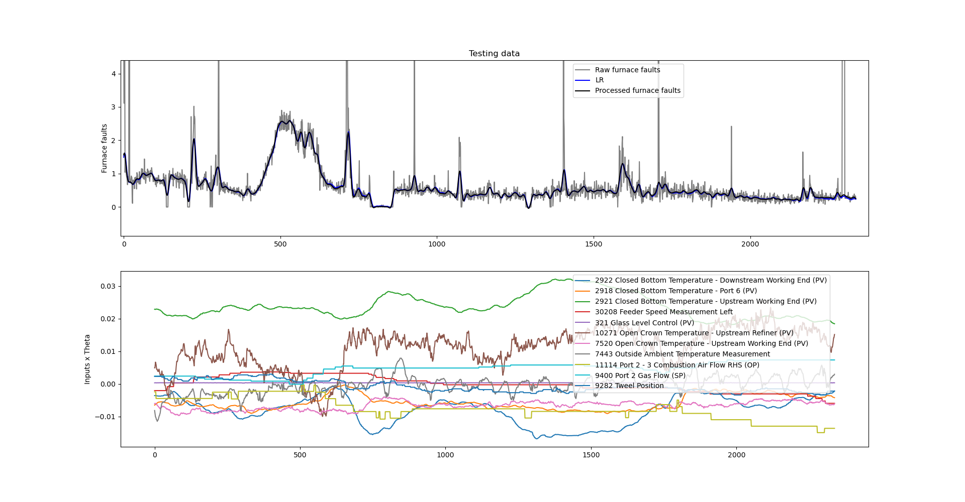
Test (1): Testing the model in the first region of the previous data from 01/08/19 to 21/03/20
After adjusting the scale

Slide 34
Test (1): Testing the model in the first region of the previous data from 01/08/19 to 21/03/20
Zoom in

Slide 35
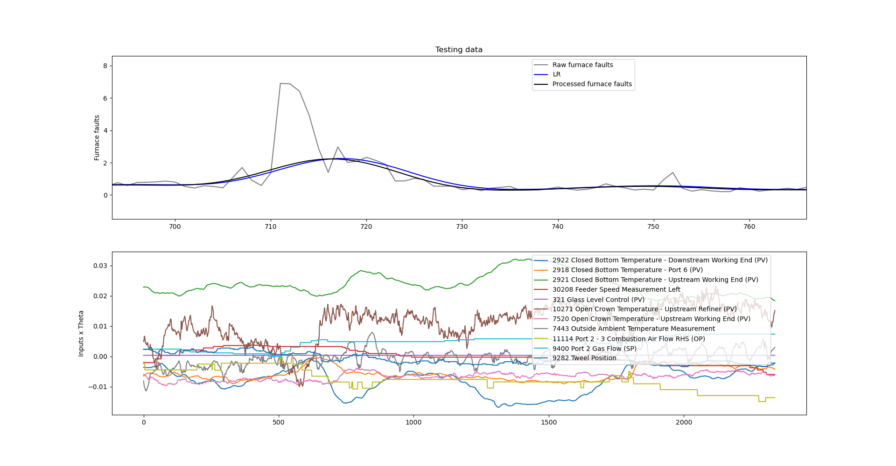
Test (1): Testing the model in the first region of the previous data from 01/08/19 to 21/03/20
Lag

Slide 36
Test (1): Testing the model in the second region of the previous data from 01/08/19 to 21/03/20 Relevant inputs
2922 Closed Bottom Temperature - Downstream Working End (PV)
2918 Closed Bottom Temperature - Port 6 (PV)
2921 Closed Bottom Temperature - Upstream Working End (PV)
30208 Feeder Speed Measurement Left
321 Glass Level Control (PV)
10271 Open Crown Temperature - Upstream Refiner (PV)
7520 Open Crown Temperature - Upstream Working End (PV)
7443 Outside Ambient Temperature Measurement
11114 Port 2 - 3 Combustion Air Flow RHS (OP)
9400 Port 2 Gas Flow (SP)
9282 Tweel Position

Slide 37
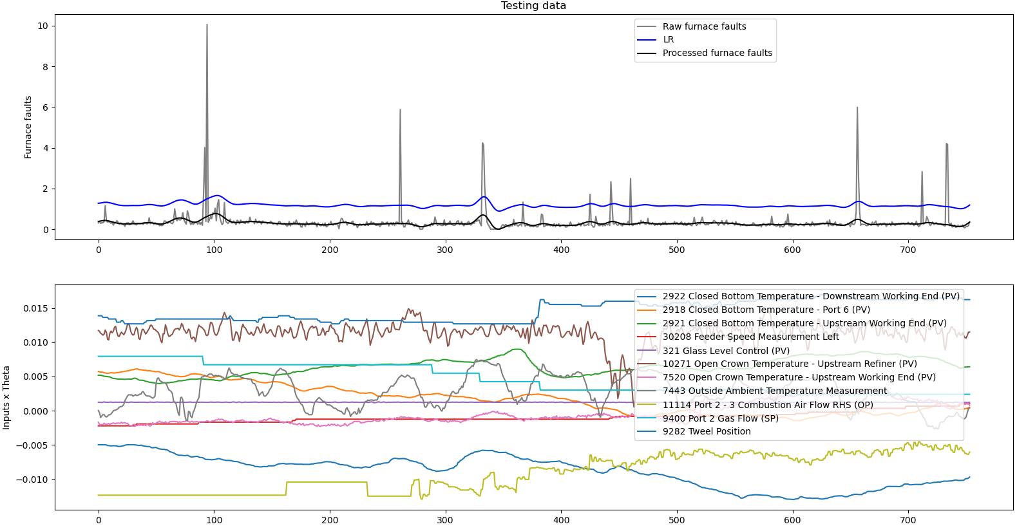
Test (2): Testing the model in the first region of the previous data from 01/08/19 to 21/03/20

Slide 38
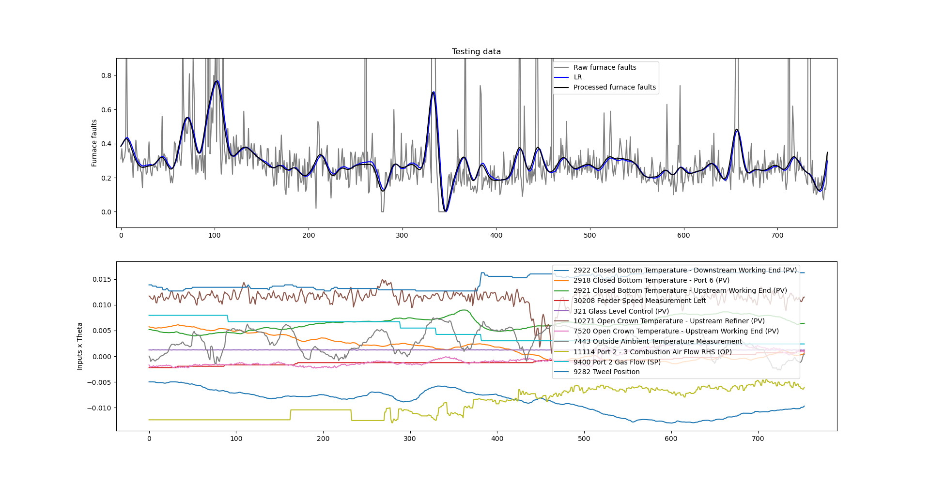
Test (2): Testing the model in the first region of the previous data from 01/08/19 to 21/03/20
After adjusting the scale

Slide 39
Test (2): Testing the model in the second region of the previous data from 01/08/19 to 21/03/20 Relevant inputs
2922 Closed Bottom Temperature - Downstream Working End (PV)
2918 Closed Bottom Temperature - Port 6 (PV)
2921 Closed Bottom Temperature - Upstream Working End (PV)
30208 Feeder Speed Measurement Left
321 Glass Level Control (PV)
10271 Open Crown Temperature - Upstream Refiner (PV)
7520 Open Crown Temperature - Upstream Working End (PV)
7443 Outside Ambient Temperature Measurement
11114 Port 2 - 3 Combustion Air Flow RHS (OP)
9400 Port 2 Gas Flow (SP)
9282 Tweel Position

Slide 40
Relevant inputs comparison
Test (1)
2922 Closed Bottom Temperature - Downstream Working End (PV)
2918 Closed Bottom Temperature - Port 6 (PV)
2921 Closed Bottom Temperature - Upstream Working End (PV)
30208 Feeder Speed Measurement Left
321 Glass Level Control (PV)
10271 Open Crown Temperature - Upstream Refiner (PV)
7520 Open Crown Temperature - Upstream Working End (PV)
7443 Outside Ambient Temperature Measurement
11114 Port 2 - 3 Combustion Air Flow RHS (OP)
9400 Port 2 Gas Flow (SP)
9282 Tweel Position
Test (2)
2922 Closed Bottom Temperature - Downstream Working End (PV)
2918 Closed Bottom Temperature - Port 6 (PV)
2921 Closed Bottom Temperature - Upstream Working End (PV)
30208 Feeder Speed Measurement Left
321 Glass Level Control (PV)
10271 Open Crown Temperature - Upstream Refiner (PV)
7520 Open Crown Temperature - Upstream Working End (PV)
7443 Outside Ambient Temperature Measurement
11114 Port 2 - 3 Combustion Air Flow RHS (OP)
9400 Port 2 Gas Flow (SP)
9282 Tweel Position
The same

Slide 41
MSE scores:
Where the new data have always been used for training the LR model.
 | LR | GP
Test (1) | 0.001078 | -
Test (2) | 0.000264 | -
Score | 0.000671 | -

Slide 42
Next activities
Standardise the lagged observations used as inputs in the autoregressive model
Updates related to the predictions beyond 20 minutes for the autoregressive Linear Regression model.
Validate the model without the autoregressive input (offline)
Incorporate a polynomial basis function
More testing data from the 2019 to 2020 period?

Slide 43
Thank you for your attention. ANY QUESTIONS?

